Slide 1
Bank Loan Case Study
Presented By : Rahul Vishwakarma

Slide 2
Project Description
As a data analyst at a finance company that provides various types of loans to urban customers. One of the key challenges we face is identifying applicants who are likely to default on their loans—especially those with limited or no credit history. These cases often lead to financial losses when high-risk applicants are mistakenly approved.
When a customer applies for a loan, the company faces two major risks:
If a capable applicant is rejected, we lose potential business.
If a high-risk applicant is approved and defaults, it results in a financial loss.
To address this, I am performing Exploratory Data Analysis (EDA) on a dataset containing information about loan applications. The dataset includes two categories:
Customers with payment difficulties – customers who made at least one late payment (over X days) in the first Y installments.
Other cases – customers who paid on time.
Each loan application has one of the following outcomes:
Approved – loan sanctioned.
Cancelled – customer withdrew during the process.
Refused – application rejected.
Unused Offer – loan approved but not taken by the customer.

Slide 3
Objective:
The aim of this project is to analyze how customer and loan attributes influence the risk of default. Through EDA, I am identifying trends and patterns that indicate whether a customer may struggle with repayments.
Business Objectives:
Detect key indicators of loan default based on applicant characteristics.
Support smarter approval decisions by identifying risky profiles early.
Reduce financial losses and improve the overall lending strategy.
This analysis helps the company make better decisions, such as denying high-risk loans, adjusting loan amounts, or offering higher interest rates to risky customers. It also ensures that capable applicants are not mistakenly rejected, which helps grow the business without increasing default risk.

Slide 4
All the analysis has been performed in excel. This tool is also used to create graphical representation of the results and to understand the result set better.

Slide 5
Handling Missing Values
1.Count of Missing Values:
used the COUNTBLANK function in Excel to calculate the total number of blank (null) values in each column.
Percentage of Missing Values:
calculated the percentage of missing values for each column using the formula:
= (Number of Missing Values in the Column / Total Row Count) * 100
Column Elimination Based on Missing Data:
Columns with more than 33% missing values were dropped from the dataset, as they were considered to have
insufficient data for meaningful analysis.
For columns with less than 33% missing values, I applied data imputation techniques to handle the missing entries.
Imputation Techniques Used:
Mean : For continuous numerical columns.
Median : For skewed numerical data.
Mode : For categorical variables.
This approach helped retain the integrity of the dataset while minimizing data loss and ensuring better model reliability
in further analysis.

Slide 6
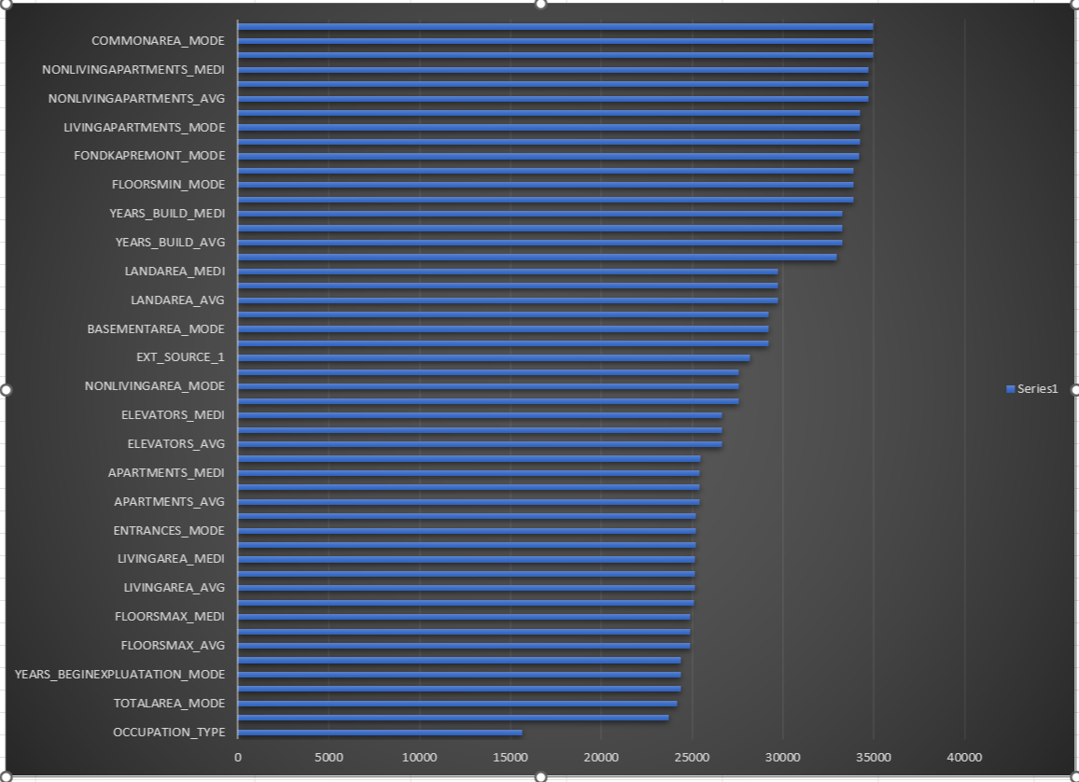
Removed Column

Slide 7
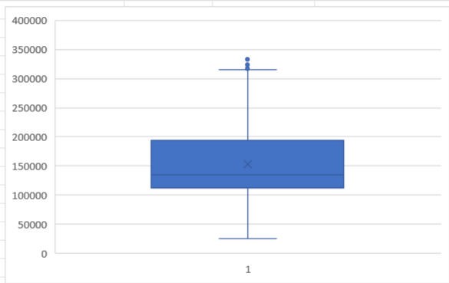
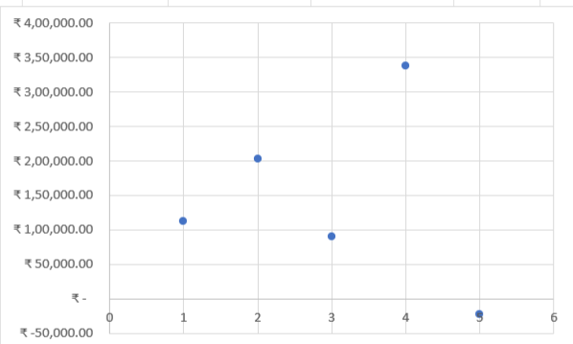
OUTLIERS
AMT_INCOME_TOTAL
The data shows Quartile 1 at ₹1,12,500 and Quartile 3 at ₹2,02,500, with an interquartile range of ₹90,000. The boxplot reveals a right-skewed distribution, with most values clustered below ₹2,00,000. There are a few higher values approaching the upper limit, indicating possible mild outliers.

Slide 8
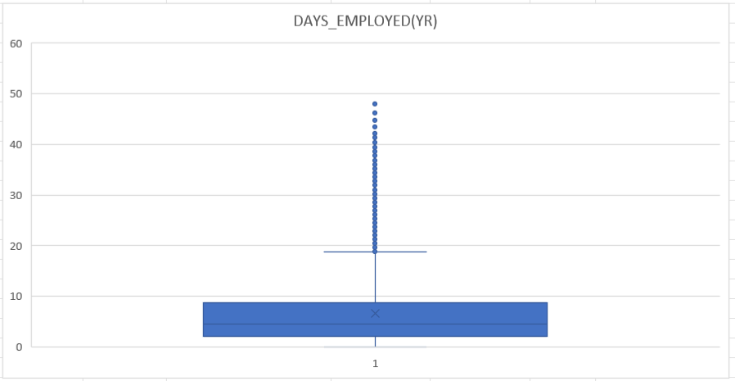
OUTLIERS
DAYS_EMPLOYED(YR)
After analyzing the data for years of employment, I found that most people have only worked for a few years, with the median being 6 years. The minimum is 0 years, which could indicate someone just started, while the maximum is an unrealistic 1,001 years—clearly a major error in the data. The average (mean) is extremely high at 184 years; this is also because of these incorrect outlier values. Most values actually fall below 16 years, and only a few extreme data points are distorting the overall picture.
The data set for employment years has major outliers and mistakes that make the average misleading. Most people have worked for less than 16 years, but impossible values (like 1,001 years) need to be fixed or removed for the analysis to be useful.

Slide 9
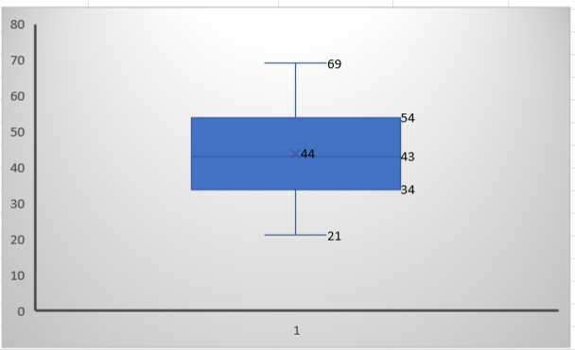
OUTLIERS
DAYS_BIRTH(YR)
The analysis of the DATS_BIRTH data reveals that most values are concentrated between 34 and 54, as indicated by the interquartile range. The mean (44), median (43), and mode (30) suggest a fairly symmetrical distribution, with a minimum of 21 and a maximum of 69. The boxplot does not show significant outliers and confirms that most data points are close to the center, with only a few at the extremes. Overall, the distribution appears balanced, and there are no serious anomalies. In conclusion, this dataset presents a reliable and typical distribution, making it suitable for further analysis or decision-making

Slide 10
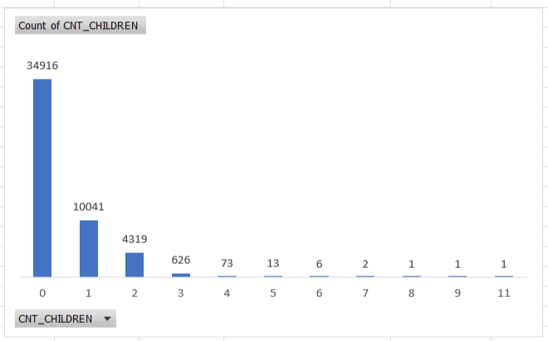
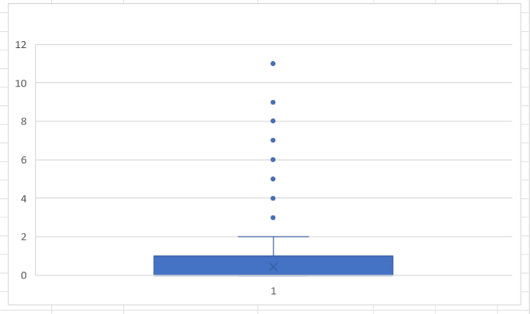
OUTLIERS
CNT_CHILDREN
By looking at the number of children (CNT_CHILDREN) in this data, it's clear that most people have no children, and only a smaller group have one or two. A very tiny number have more than five children, and the highest is 11, which is very rare. The average number of children is less than one, showing that having no or just one child is most common. Most of the data is tightly grouped at the low end, and the spread (variation) is small, though there are a few unusual cases with many children. In conclusion, this group mainly consists of people with few or no children, and only a handful of families are larger outliers

Slide 11

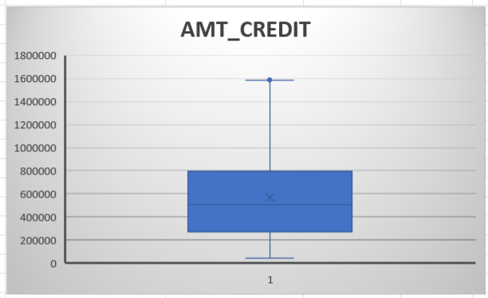
OUTLIERS
AMT_CREDIT
Looking at the credit amount data (AMT_CREDIT), most people in this group get credits between ₹2,70,000 and ₹8,08,650, with an average of around ₹5,99,700. The middle value is slightly lower at ₹5,14,777, which means many people receive amounts below the average due to a few very large credits pulling the mean up. The smallest credit is ₹45,000, while the largest is ₹40,50,000, but such high values are extremely rare and can be seen as outliers. Overall, most people get moderate-sized credits, and only a handful get unusually large amounts, so the main takeaway is that typical credit amounts are clustered in the lower range, with few exceptions

Slide 12
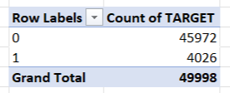
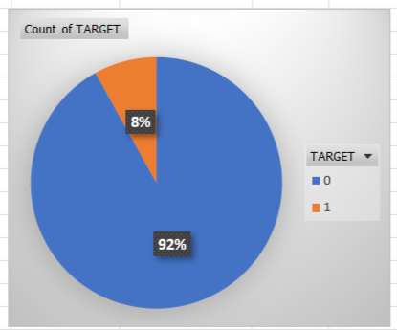
Data Imbalance
The loan application dataset shows a strong data imbalance between classes. About 92% of records belong to class 0 (no default) and only 8% to class 1 (default), as reflected in both the summary table and the pie chart. This means the vast majority of applicants do not default, while a small portion do. Such an uneven distribution may impact the performance of predictive models, making them biased toward predicting the majority (non-default) class. To ensure accurate and fair results, it is important to address this imbalance—using techniques like oversampling the minority class, undersampling the majority, or applying specialized algorithms for imbalanced data.

Slide 13
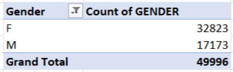
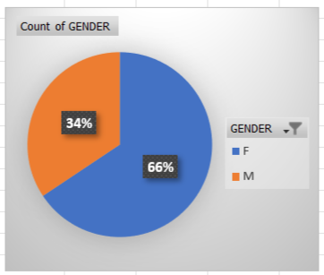
Data Imbalance
The loan application dataset shows a strong data imbalance between classes. About 92% of records belong to class 0 (no default) and only 8% to class 1 (default), as reflected in both the summary table and the pie chart. This means the vast majority of applicants do not default, while a small portion do. Such an uneven distribution may impact the performance of predictive models, making them biased toward predicting the majority (non-default) class. To ensure accurate and fair results, it is important to address this imbalance—using techniques like oversampling the minority class, undersampling the majority, or applying specialized algorithms for imbalanced data.

Slide 14
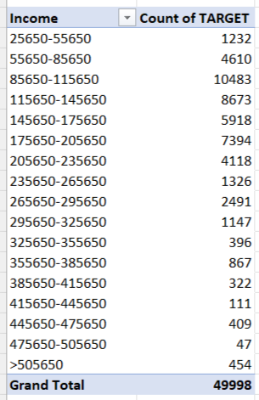
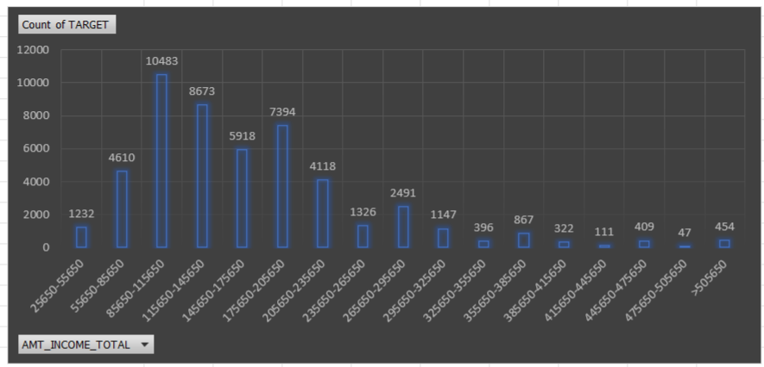
UNIVARIATE ANALYSIS
Looking at the income data, most people have incomes between ₹85,650 and ₹175,650. The highest group is ₹85,650–₹115,650, with over 10,000 records. Very few people have incomes above ₹385,650, and hardly anyone earns more than ₹505,650. This means the majority of people in the dataset fall into the low to middle-income ranges, with only a small number earning very high incomes.
In conclusion, the income data is mostly concentrated in the low to middle ranges, with very few people earning high incomes.

Slide 15

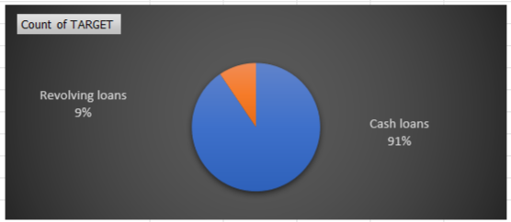
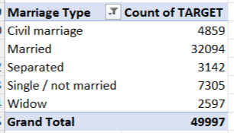
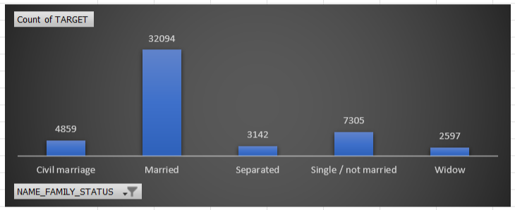
UNIVARIATE ANALYSIS
Looking at the types of loans, most people in the dataset have taken cash loans, making up about 91% of all loans. Only a small portion, around 9%, have chosen revolving loans. This shows a very strong preference for cash loans among the applicants. Because cash loans are much more common, most patterns or trends you find in the data will be about cash loans.
The family status of people who applied for loans, most applicants are married—this group is much bigger than any other, with over 32,000 records. Single people and those in a civil marriage come next but have much smaller counts. Separated and widow categories have the fewest applicants. This tells us that married people make up the largest share of loan customers, while widows and separated people are least common

Slide 16
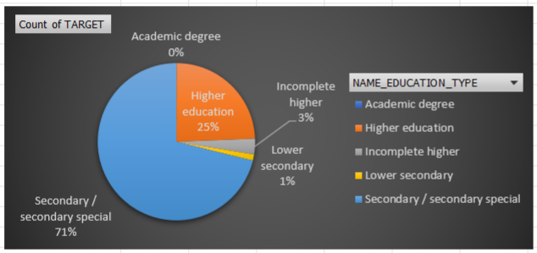
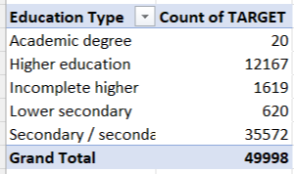
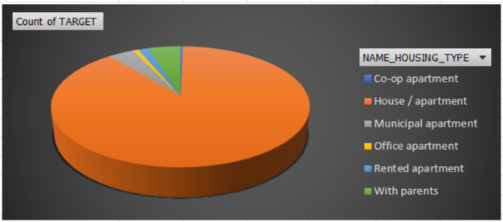
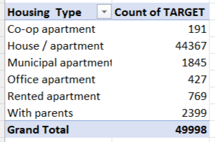
UNIVARIATE ANALYSIS
The education types of people in this dataset, the vast majority have finished secondary (high school) education—almost 36,000 out of 50,000 records. Higher education, like college or university, is the next most common, but there are only about 12,000 people in this group. Very few people have an academic degree (like a PhD), lower secondary education, or incomplete higher education. This means most people who applied have just a basic school education, and only a small number went on to advanced or university-level studies.
the education types of people in this dataset, the vast majority have finished secondary (high school) education—almost 36,000 out of 50,000 records. Higher education, like college or university, is the next most common, but there are only about 12,000 people in this group. Very few people have an academic degree (like a PhD), lower secondary education, or incomplete higher education. This means most people who applied have just a basic school education, and only a small number went on to advanced or university-level studies.

Slide 17
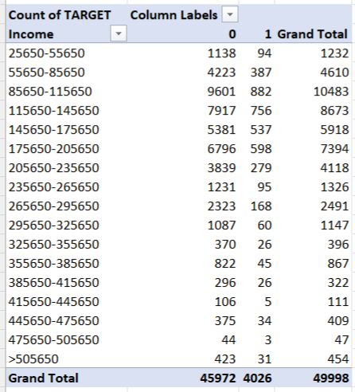
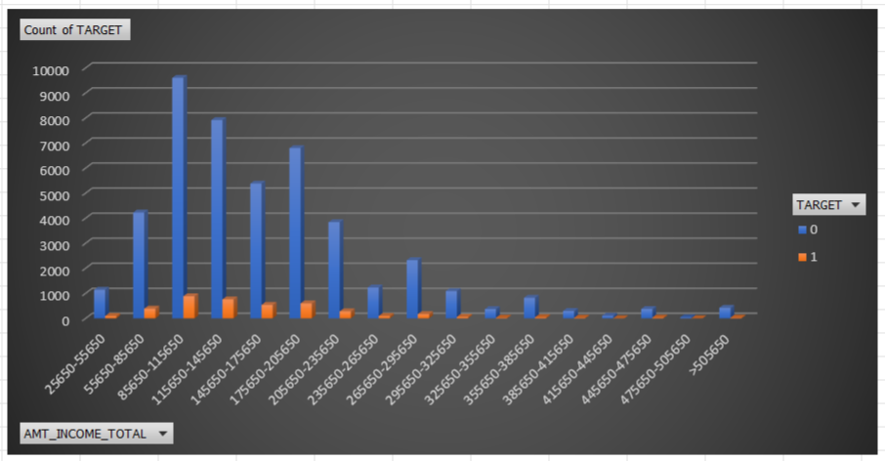
Segmented Univariate Analysis
From the income-wise segmentation, it is observed that customers with an income between ₹85,650 and ₹1,15,650 form the largest group and also have a high number of defaults (882 cases). The default rate seems to increase slightly in middle-income groups and then decline in higher-income brackets. The lowest number of defaults is seen in the highest income group (>₹5,05,650), indicating that higher-income customers are less likely to default. This suggests a trend where default risk is higher in the mid-income segments, and the company should be more cautious while approving loans in those income ranges.

Slide 18
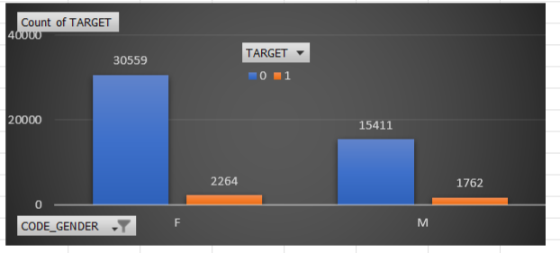
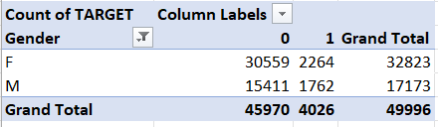
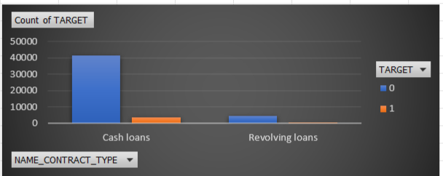
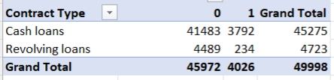
Segmented Univariate Analysis
Looking at both gender and loan default status, we see that most people—whether male or female—do not default on their loans. Among females, about 93% did not default, while only 7% did. Among males, 90% did not default, and 10% did. There are more females in the data overall, but in both groups, defaulting on a loan is still quite rare. This means that, regardless of gender, most applicants pay back their loans, although a slightly higher percentage of males default than females
When we look at the types of loans and whether people defaulted, most people in both groups did not default. For cash loans, out of about 45,000 applications, only around 3,800 ended in default, while for revolving loans, just 234 defaulted out of about 4,700. This means defaults are uncommon for both loan types, but cash loans are much more popular—almost ten times more common than revolving loans. So, no matter the loan type, paying back is the usual result, but cash loans make up the biggest part of the dataset.

Slide 19
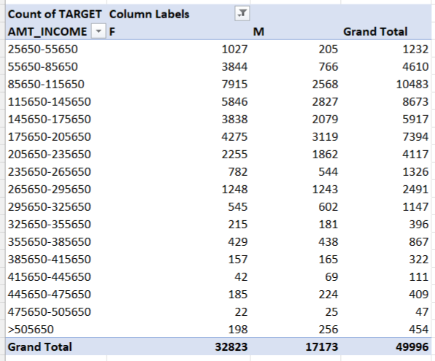
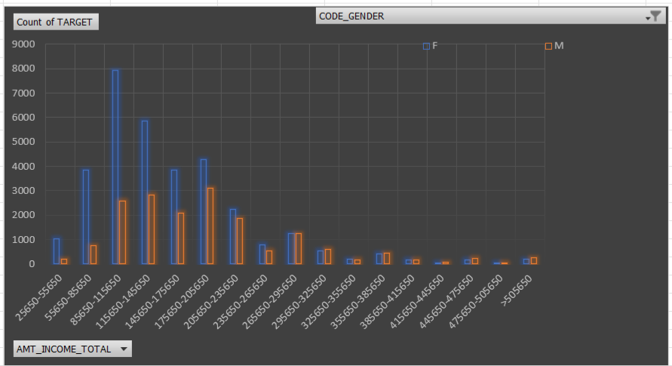
Bivariate Analysis
When we look at the data grouped by income and split it by gender, we see that most people in every income category are females, especially in the middle-income brackets. Within each income group, both males and females usually pay back their loans—defaults are low for everyone. For example, in the ₹85,650 to ₹145,650 range, non-defaulters are much more common than defaulters for both genders. High-income groups (above ₹385,650) have very few people, and in these categories, almost no one defaults. The vast majority of applicants, whether male or female, come from low and middle-income groups. Also, across all these segments, it is clear that paying back the loan on time is the most frequent result. This shows that gender or income level doesn’t make a big difference in whether people repay loans—defaults are always the exception, not the rule.

Slide 20
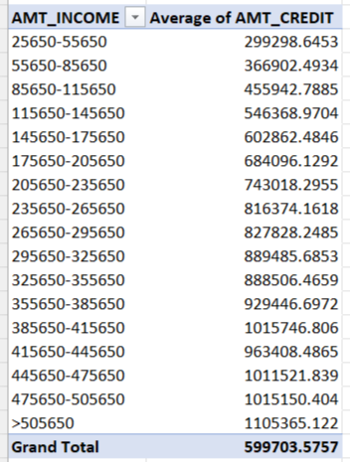
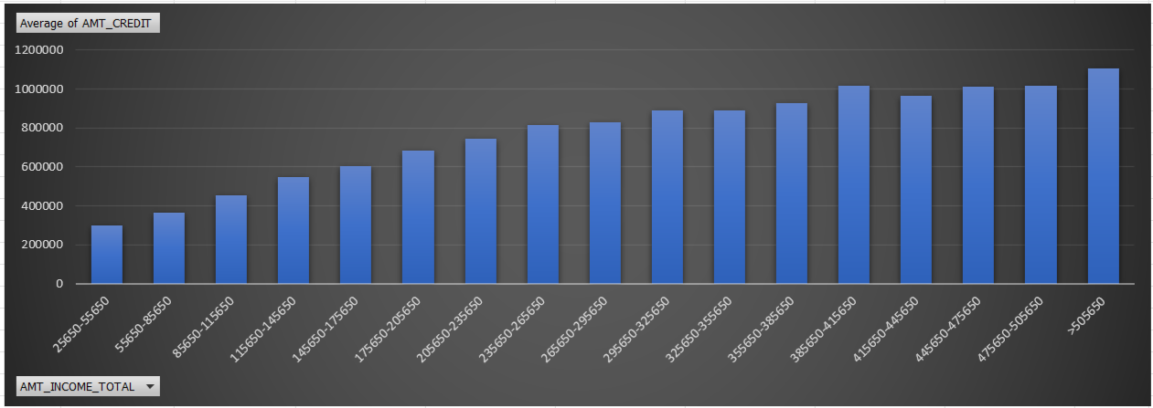
Bivariate Analysis
When we look at the average credit amount given to people in each income group, there’s a clear pattern: as income increases, the average loan amount also goes up. People in the lowest income range (₹25,650–₹55,650) get an average credit of about ₹3 lakh, while those with the highest incomes (above ₹5 lakh) get loans averaging over ₹11 lakh. Most people fall into the low to middle-income ranges, where the average credit is between ₹3 lakh and ₹8 lakh. Only a small number of people are in the high-income groups, but they receive much larger loans. This shows that banks or lenders are willing to offer higher loan amounts to people who have bigger incomes, probably because they are more likely to pay it back. Overall, most loans are of moderate size, and only a few very high-income individuals get very large credits.

Slide 21
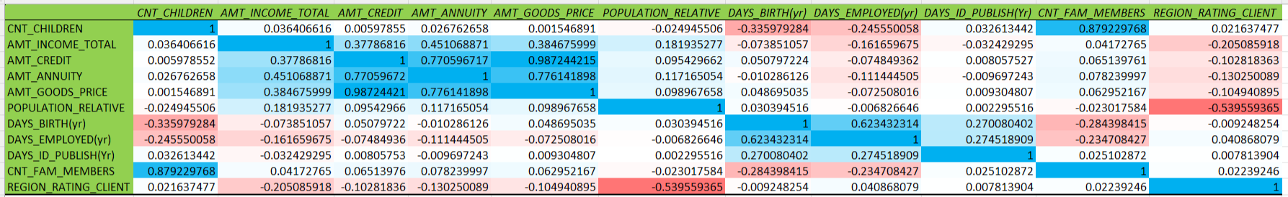
Bivariate Analysis
Moderate to Weak Relationships:
Strong Positive Relationships:
Some features, like loan amount (AMT_CREDIT) and goods price (AMT_GOODS_PRICE), are very closely related. Since they carry similar information, we may not need both in the final model.
The relationships between income, loan amount, and annuity show that a customer’s financial strength plays an important role in loan approval.
Features like age and employment duration also show clear patterns—older people usually have longer work histories and may be more stable. This is useful in identifying low-risk borrowers.
Family details (like number of children and family members) and region-related data can also offer helpful insights, but they might need more analysis before being used directly.
AMT_CREDIT and AMT_GOODS_PRICE (0.98):
This indicates that loan are often taken specifically to finance goods, suggesting predictable and structured borrowing behavior.
AMT_ANNUITY with AMT_GOODS_PRICE (0.78):
This is expected, as annuity payments depend both on loan amount and repayment terms.
AMT_CREDIT and AMT_ANNUITY (0.77):
Higher loan amounts naturally result in higher annuity payments. This supports the assumption that annuity can be a good proxy for loan size.
AMT_INCOME_TOTAL shows moderate correlations with AMT_ANNUITY (0.45) and AMT_GOODS_PRICE (0.38):
While not extremely high, this suggests income levels impact the size of the loan and the nature of goods financed.
CNT_CHILDREN and CNT_FAM_MEMBERS (0.88):
Families with more children naturally have more family members. These two features are highly related, and one might be dropped during modeling to avoid multicollinearity.
REGION_RATING_CLIENT and POPULATION_RELATIVE (-0.54):
Customers in higher-rated regions tend to live in less densely populated areas. This may reflect better living conditions or more rural/suburban environments.

Slide 22
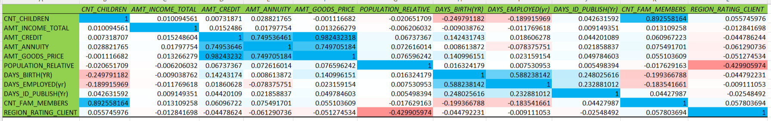
Bivariate Analysis
Strong Positive Relationships:
Strong correlation exists between AMT_CREDIT and AMT_GOODS_PRICE (0.98), showing defaulters borrow almost the full value of goods.
CNT_CHILDREN and CNT_FAM_MEMBERS are highly correlated (0.89), indicating redundancy.
Weak relationships between AMT_INCOME_TOTAL and loan-related variables suggest income is not a strong predictor of default.
DAYS_BIRTH and DAYS_EMPLOYED show moderate correlation (0.58), implying older people tend to have longer work history—even among defaulters.
Regional rating is negatively correlated with population density (-0.42), meaning better regions are less crowded—but this has unclear impact on default behavior.

Slide 23
The bank must give special attention to outliers in employment years and income data, as they can skew analysis and affect risk assessment. Due to the imbalanced dataset, modeling should use proper techniques like oversampling, undersampling, or specialized algorithms to avoid bias toward non-defaulters. Many defaulters fall within the middle-income group, highlighting the need for extra checks for applicants earning between ₹85,650 and ₹1,15,650. The strong correlation between loan amount and goods price indicates that most loans are taken to buy specific items—this can help predict the purpose of the loan. Features like income, age, and employment show weak or unclear patterns among defaulters, so loan approval should not depend on these alone. Customers with shorter work history or unrealistic employment records (like 1,001 years) must be reviewed or flagged automatically. Although married applicants dominate the dataset, male clients show a slightly higher default rate and may require deeper profiling. Clients from densely populated but high-rated regions still appear in the defaulter group, suggesting demographic data needs further review. Most defaulters prefer cash loans, so stricter risk checks should be applied to this product type.
Conclusion

Slide 24
Thank You

